Slide 1
AI News Summarizer with Guardrails & Automation
(AI)

Slide 2
1.“In today’s digital era, people are overwhelmed by the volume of news.” 2.Global users encounter information overload across multiple news sources. 3.Articles are often lengthy, repetitive, or biased. 4.Manual browsing consumes time and effort. 5.There is a strong need for an AI-driven automation system that summarizes and filters news accurately and ethically.
AUTOMATION USE CASE:

Slide 3
Motivation
My interest lies at the intersection of AI, Automation, and Real-World Applications.
This use case showcases how LLMs can act as intelligent agents
— not just text generators.
Building this project helped me explore:
API integration
Prompt engineering
Guardrail-based reasoning
Error-resilient automation
The system makes daily information consumption smarter, faster, and safer.

Slide 4
Project Objective
To design and implement an Agentic AI-based automation system that:
Collects and validates real-time news from multiple categories and regions.
Summarizes and analyzes news using Google Gemini.
Applies guardrails to ensure safe and unbiased content generation.
Provides an interactive, automated web interface for users.

Slide 5
Solution Overview
Step | Function | Technology
1 | Fetch headlines from trusted APIs | NewsAPI
2 | Validate & sanitize inputs | Regex Guardrails
3 | Generate AI summaries & sentiment | Gemini 2.5 Flash
4 | Handle errors & fallbacks | Python logic
5 | Present interactive dashboard | Streamlit

Slide 6
Agentic Components Implemented:
🧠 Reasoning: Model interprets news context and
summarizes insights.
🛡️ Guardrails: Regex validation + bias filtering.
🔁 Handoff Mechanism: Switches automatically to extractive summary when LLM fails.
⚙️ Autonomy: System operates end-to-end with minimal user input.
📊 Feedback Loop: Interactive interface guides users through results and alerts.

Slide 7
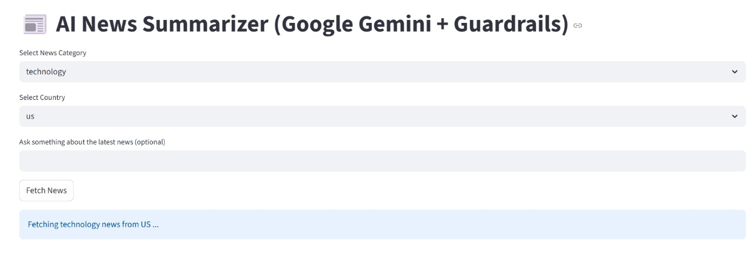
Automation & Intelligence
Automated Processes:
Real-time API data fetching.
Summarization pipeline triggered on user input.
Automatic handling of empty or invalid responses.
Smart fallbacks ensuring continuous operation.
Intelligent Additions:
Gemini used for context-aware summarization.
Sentiment tagging provides deeper insight into overall tone.
Key UI Elements:
Category and region selectors.
Real-time fetch button.
Gemini summary and sentiment analysis display.
Clean layout with images, sources, and timestamps.

